Slide 1
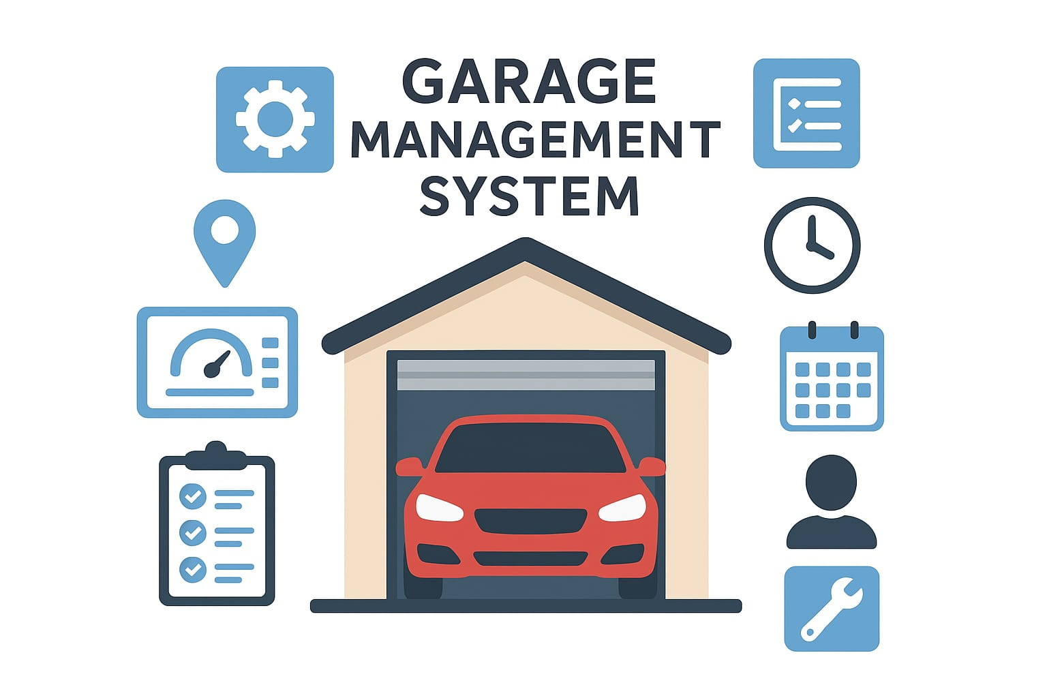

Slide 2
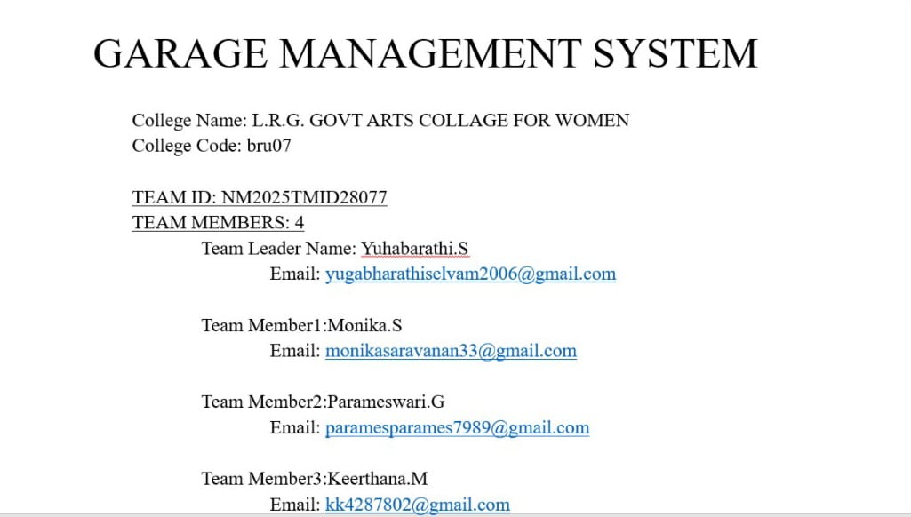

Slide 3
1.INRODUCTION
1.1 Garage management system overview
A Garage Management System (GMS) is a software solution designed to automate and streamline the operations of a garage or automobile service center.
Service records
Customer details
GARAGE MANAGEMENT SYSTEM
Billing details and feedback
Appointment

Slide 4
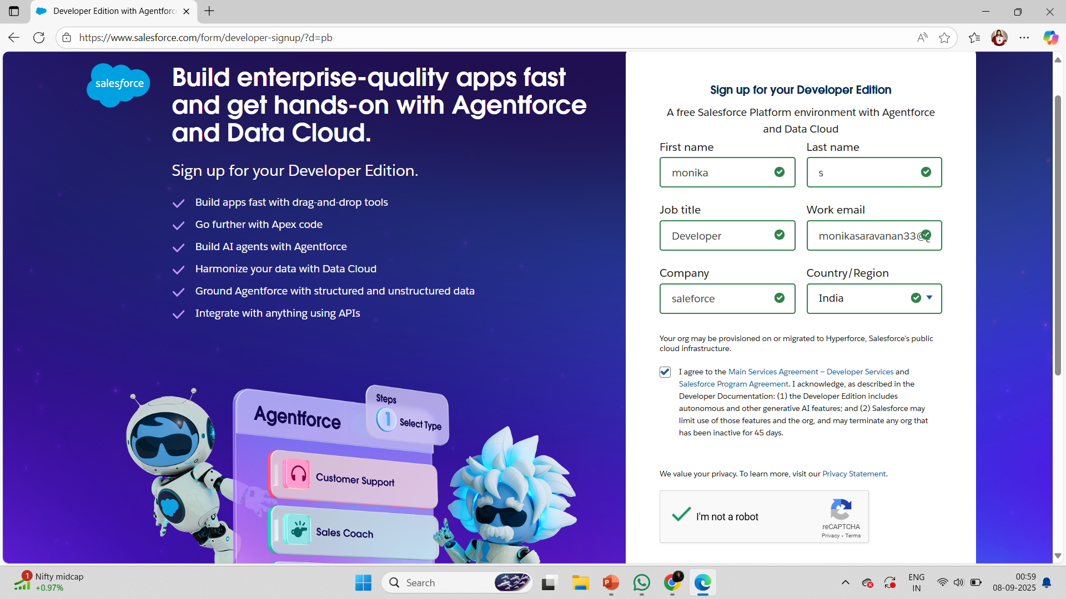
1.2 Purpose
The purpose of a Garage Management System (GMS) is to digitize and streamline garage operations so that both customers and garage staff benefit from efficiency, accuracy, and transparency.
DEVELOPMENT PHASE
Creating developer account:
By using this URL - https://www.salesforce.com/form/developer-signup/?d=pb

Slide 5
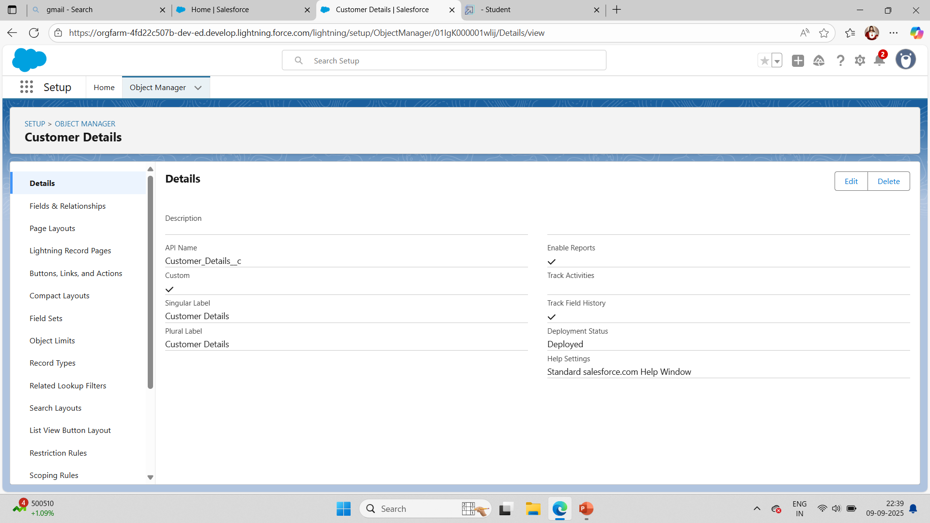
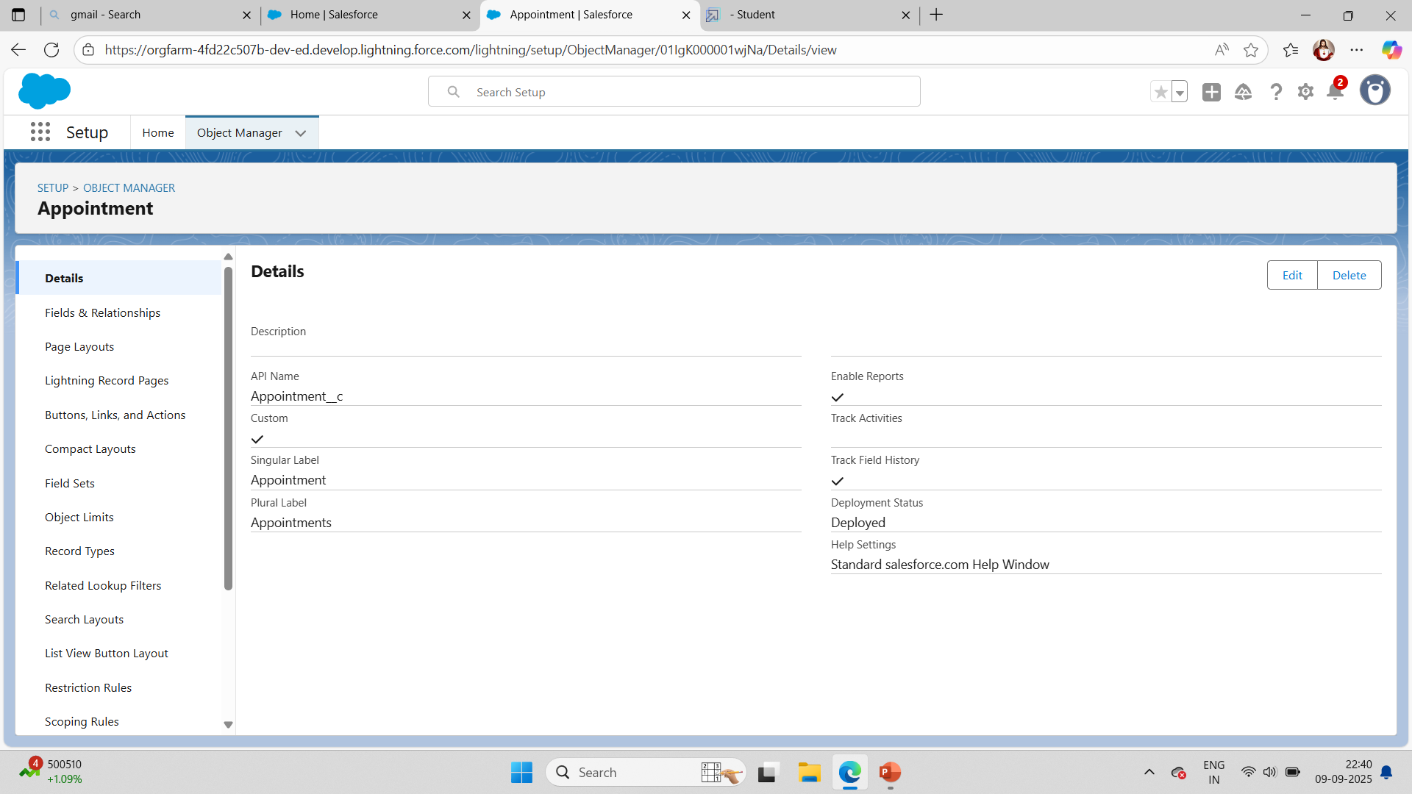
created objects : Customer details,Appointment,Service records,Billing details and feedback

Slide 6
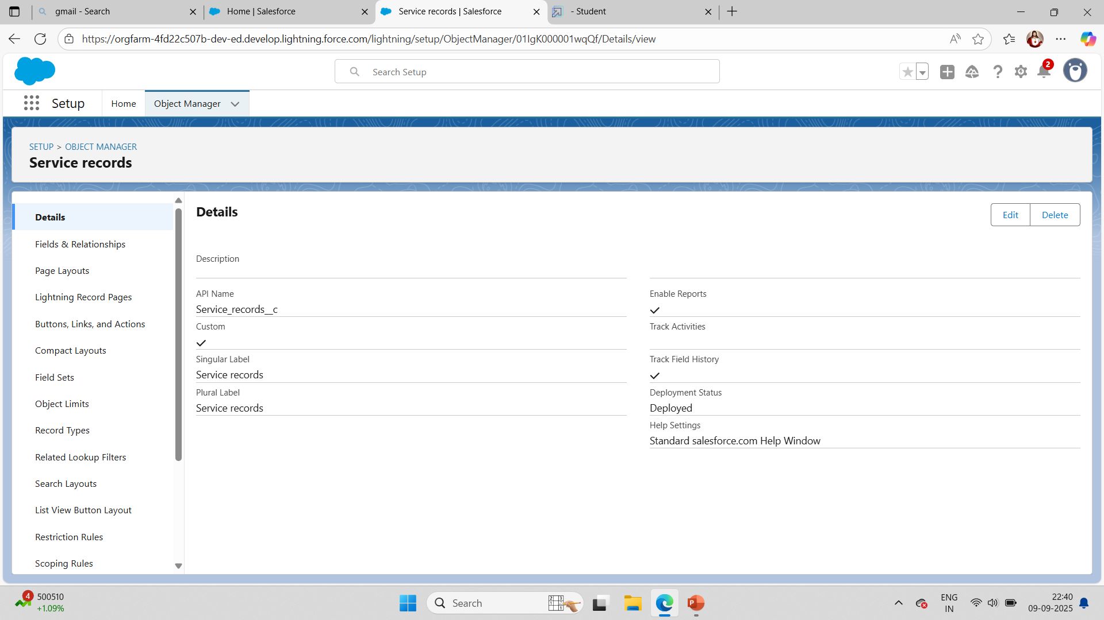
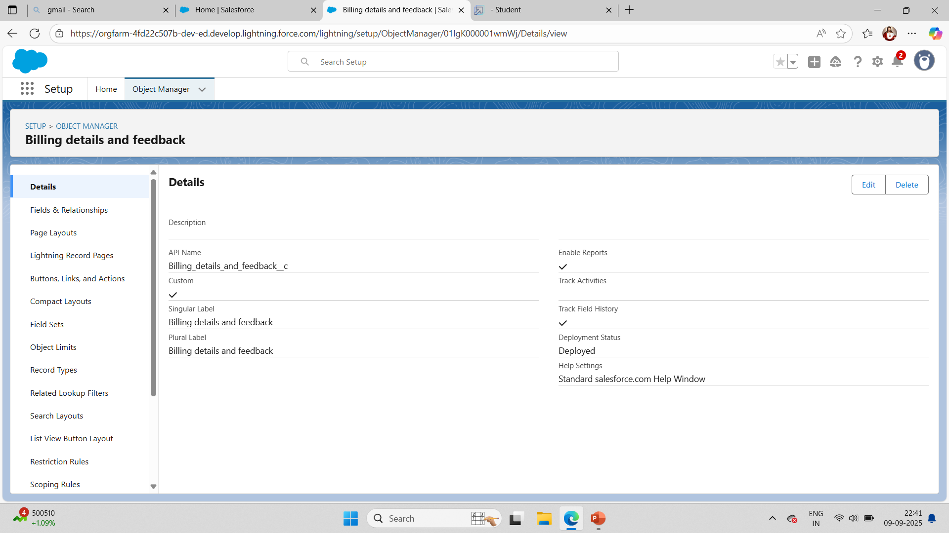

Slide 7
Configured field and relationships

Slide 9
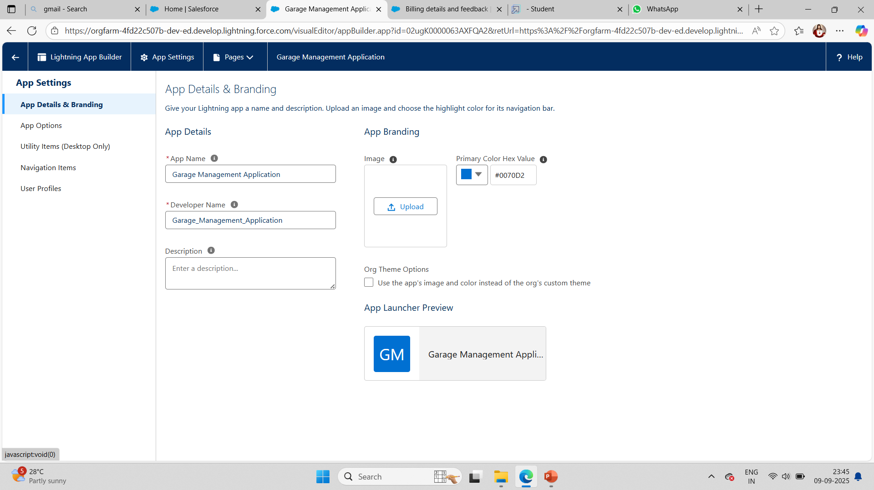
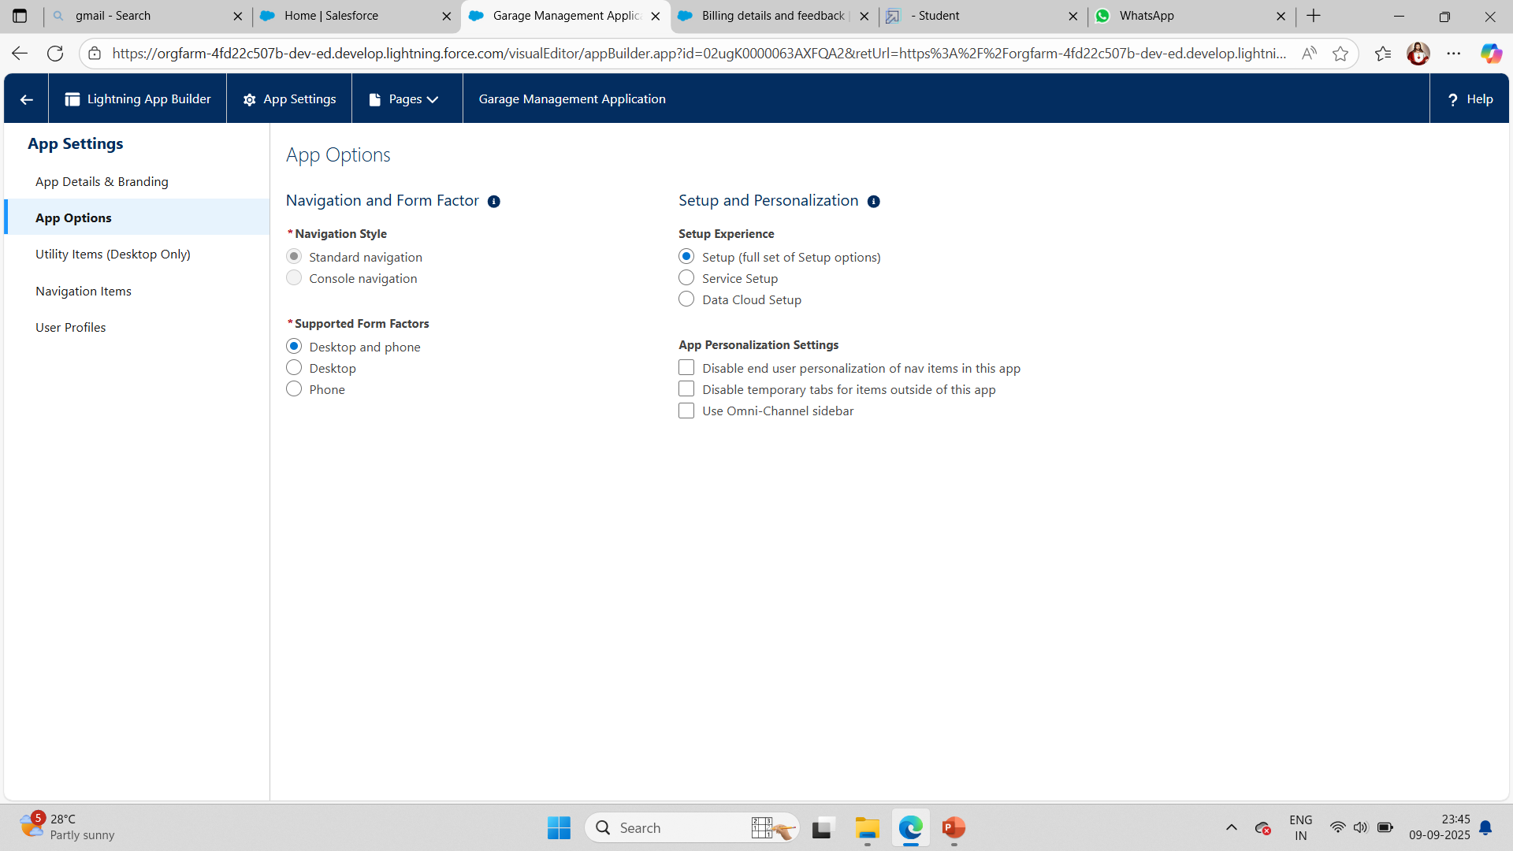
Developed Lightning App with relevant tabs

Slide 10
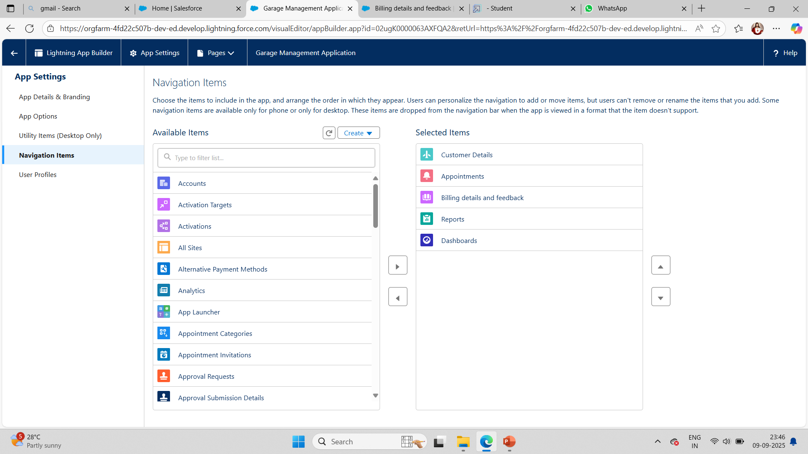
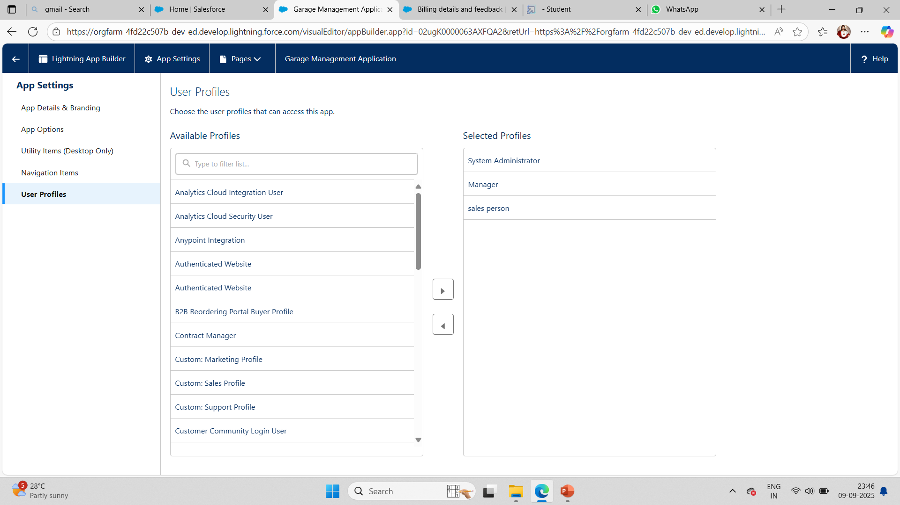

Slide 11
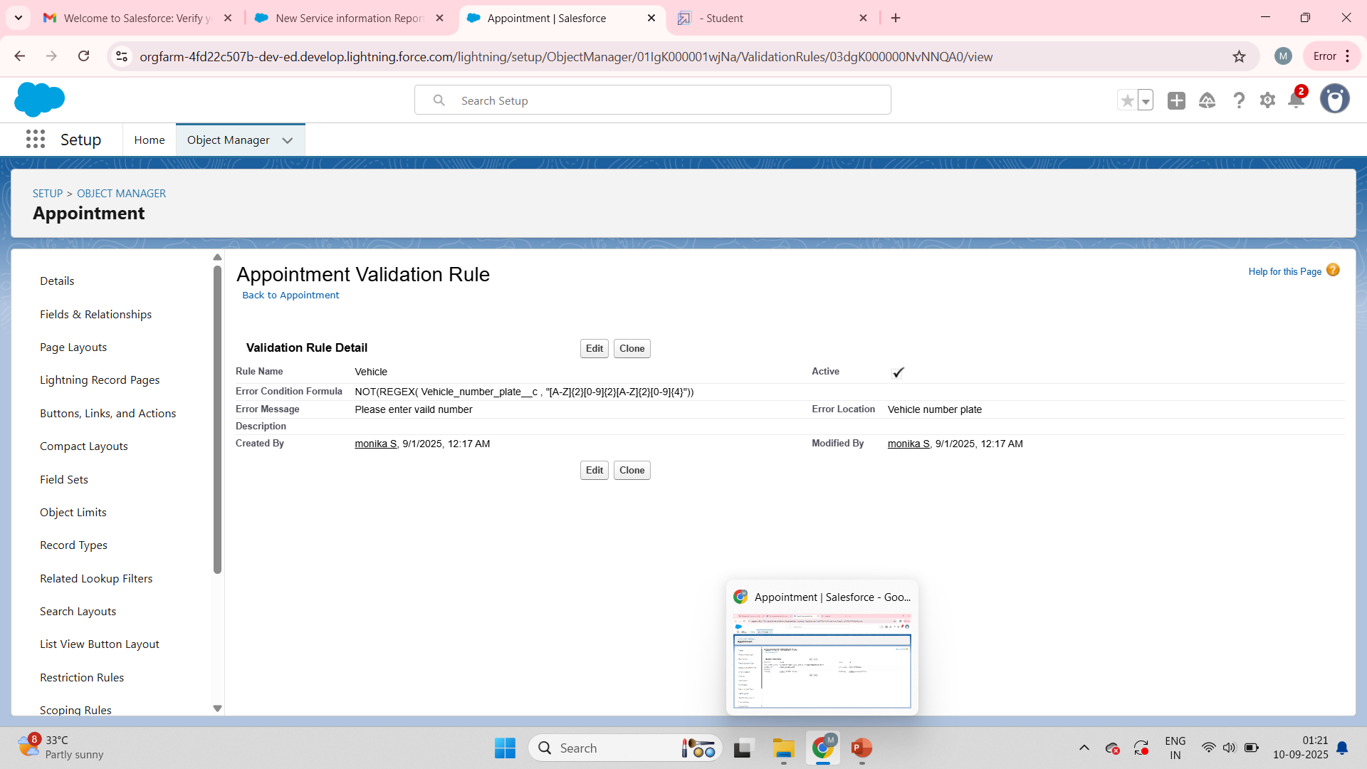
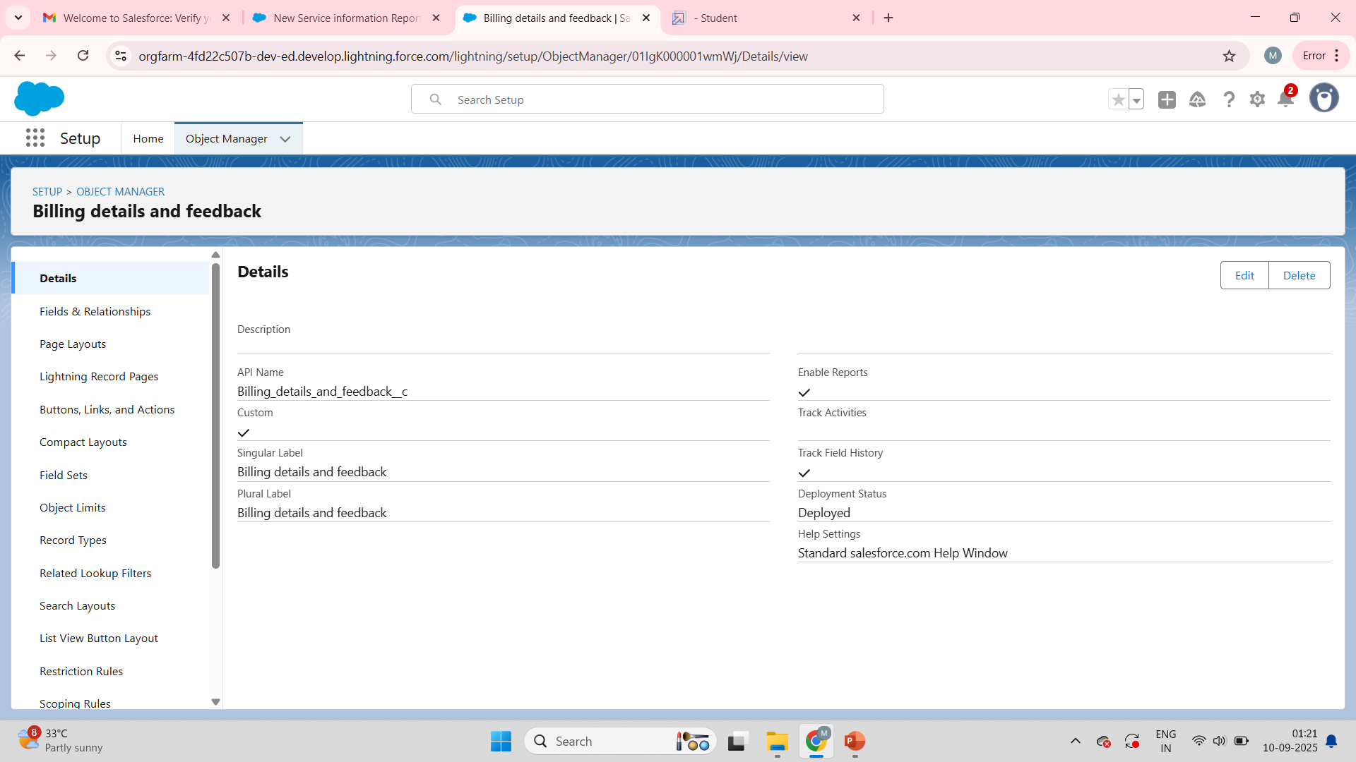
To create a validation rule

Slide 12
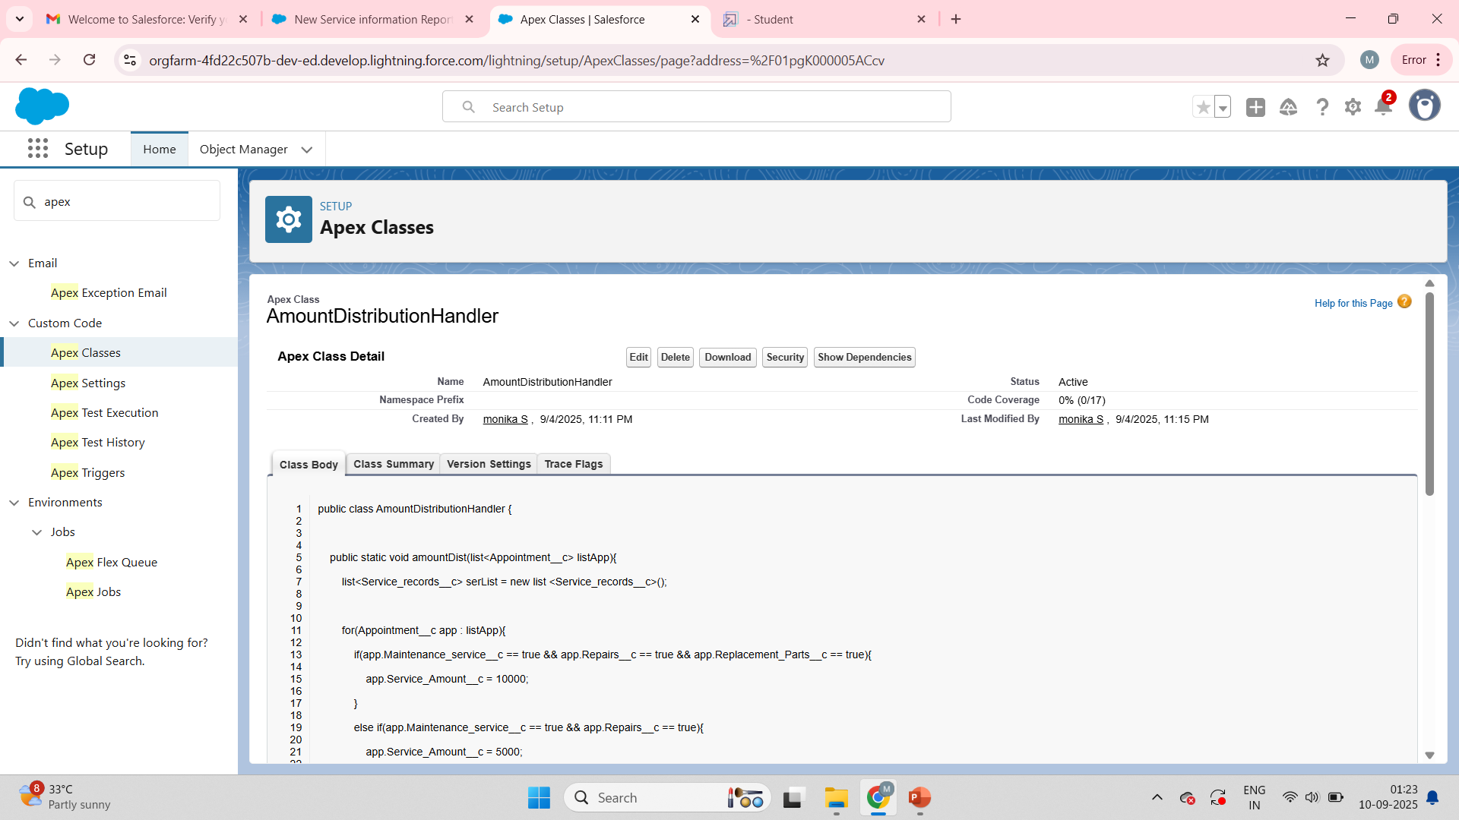
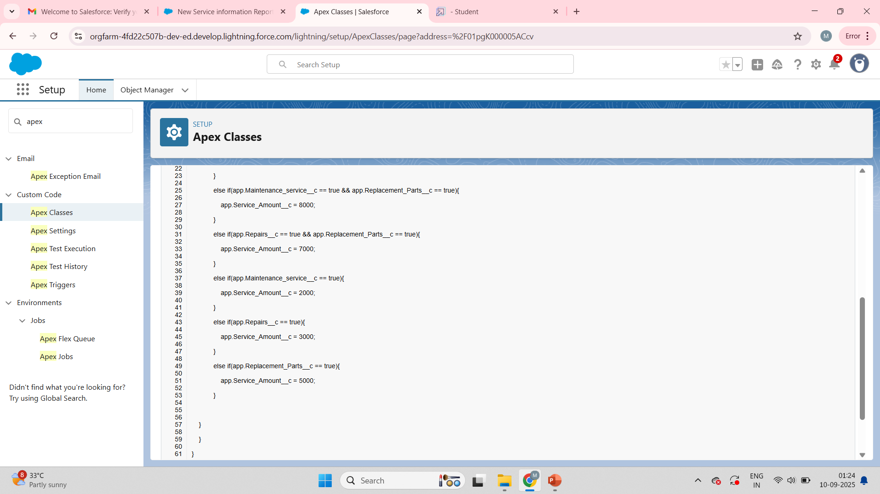
To create a apex classes

Slide 13
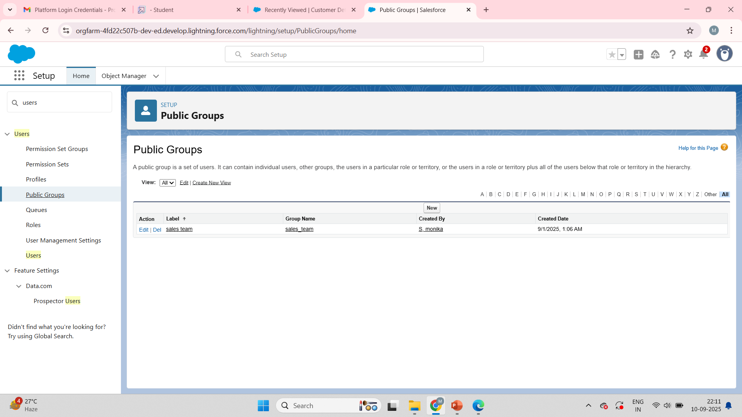
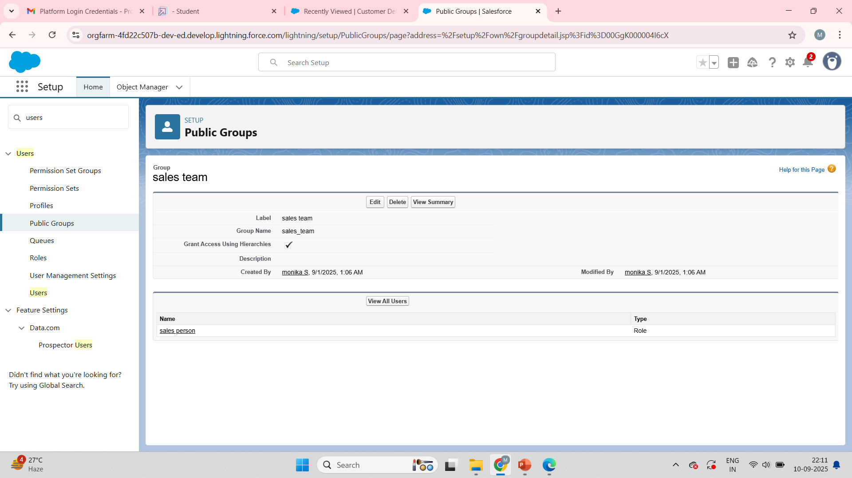
To create a public group as sales team

Slide 14
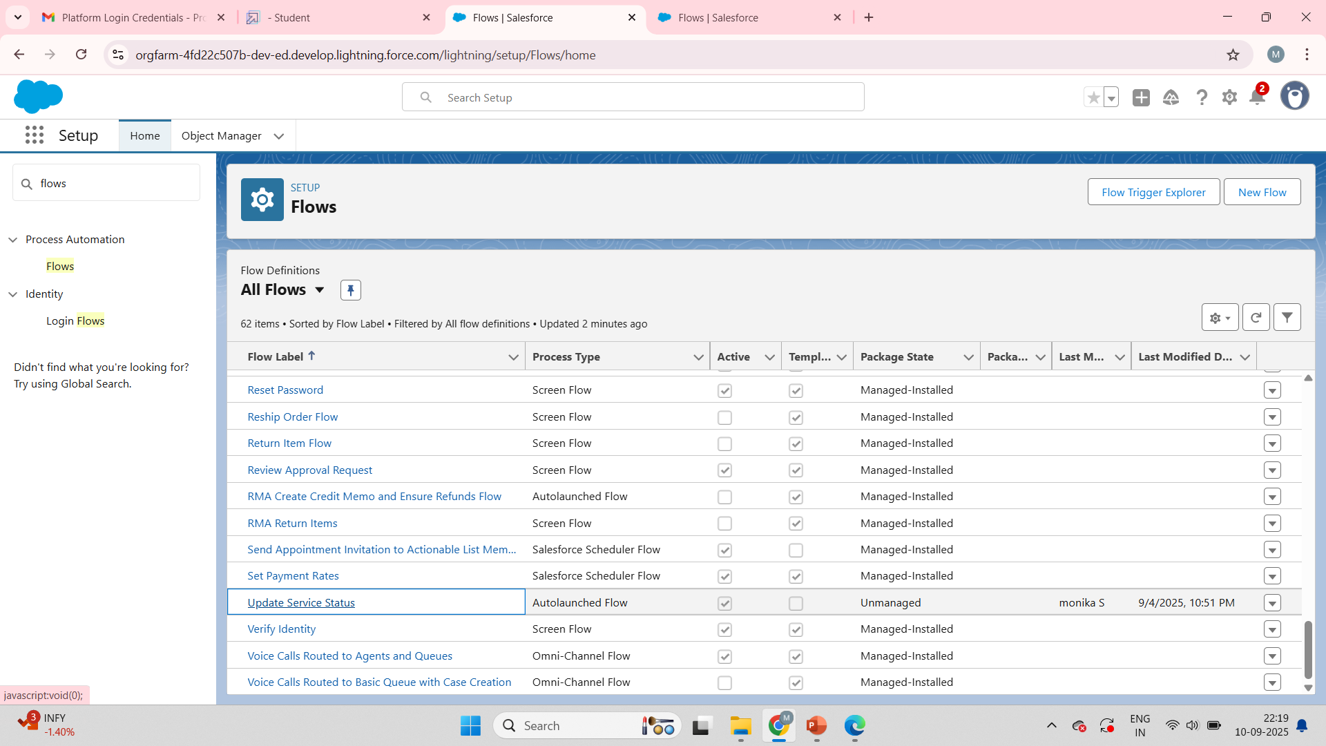
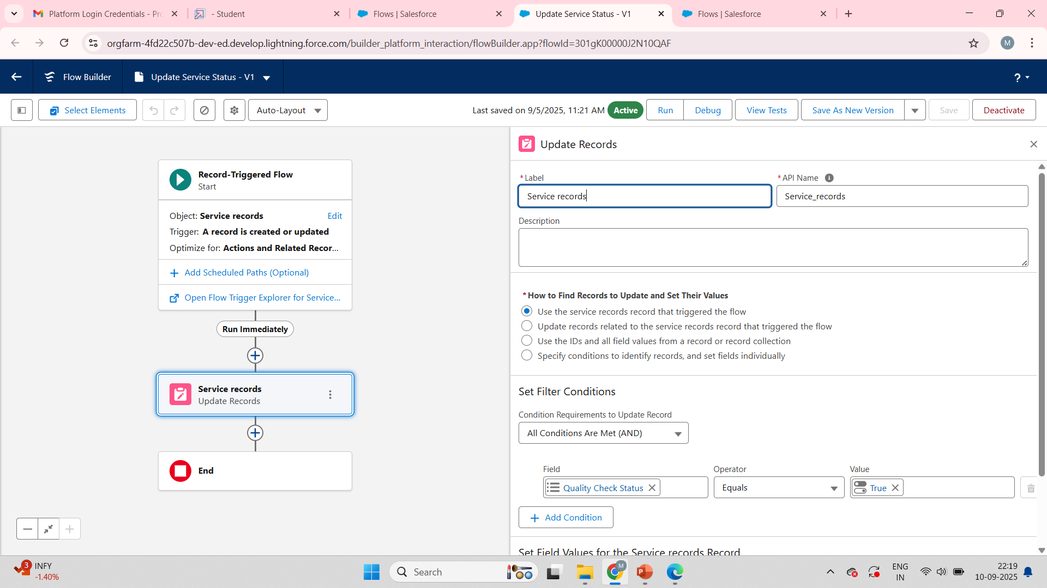
To create a flow as service records

Slide 15
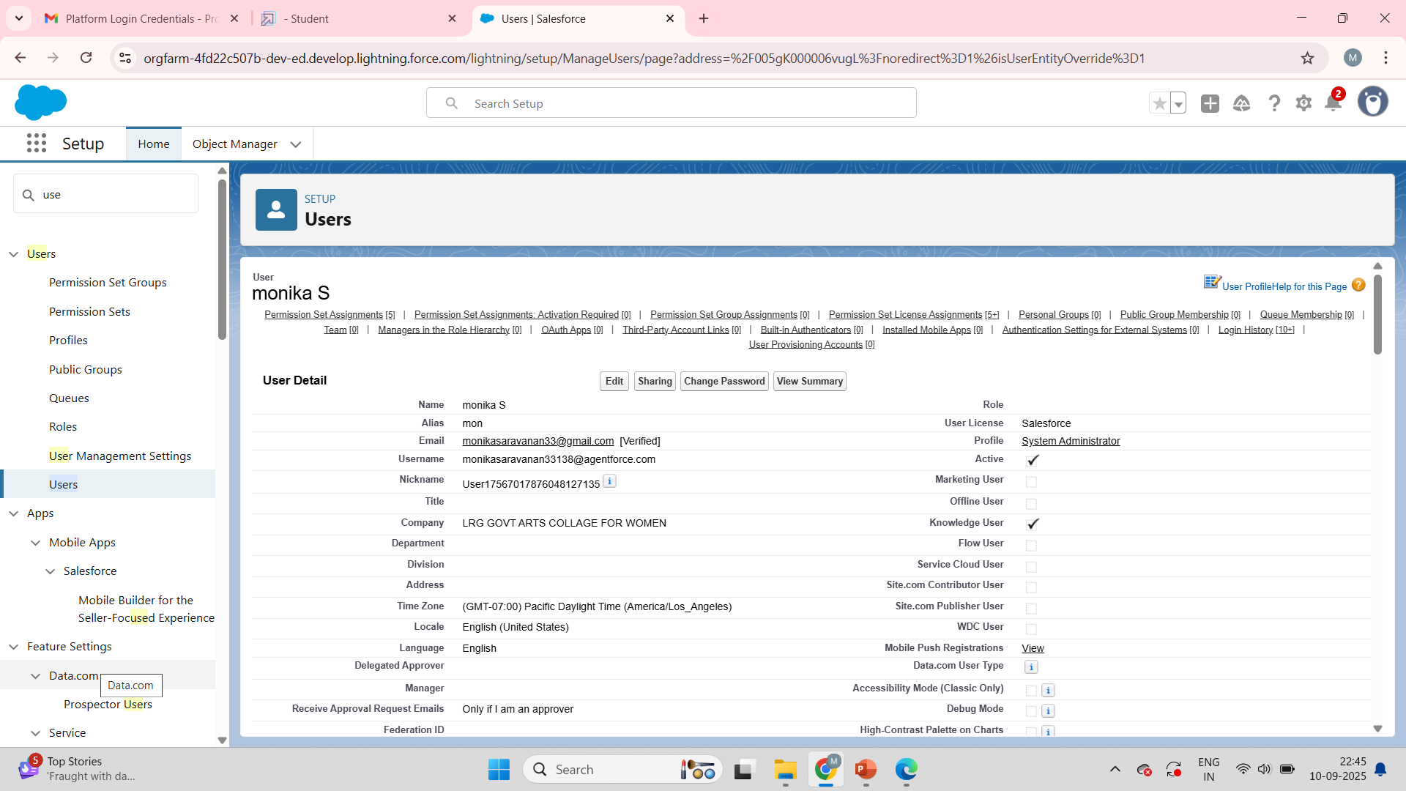
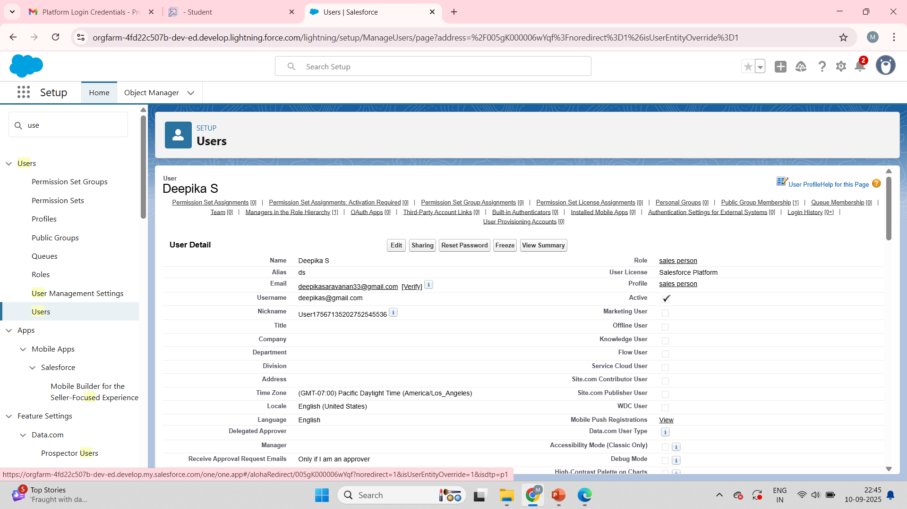
To create a users

Slide 16
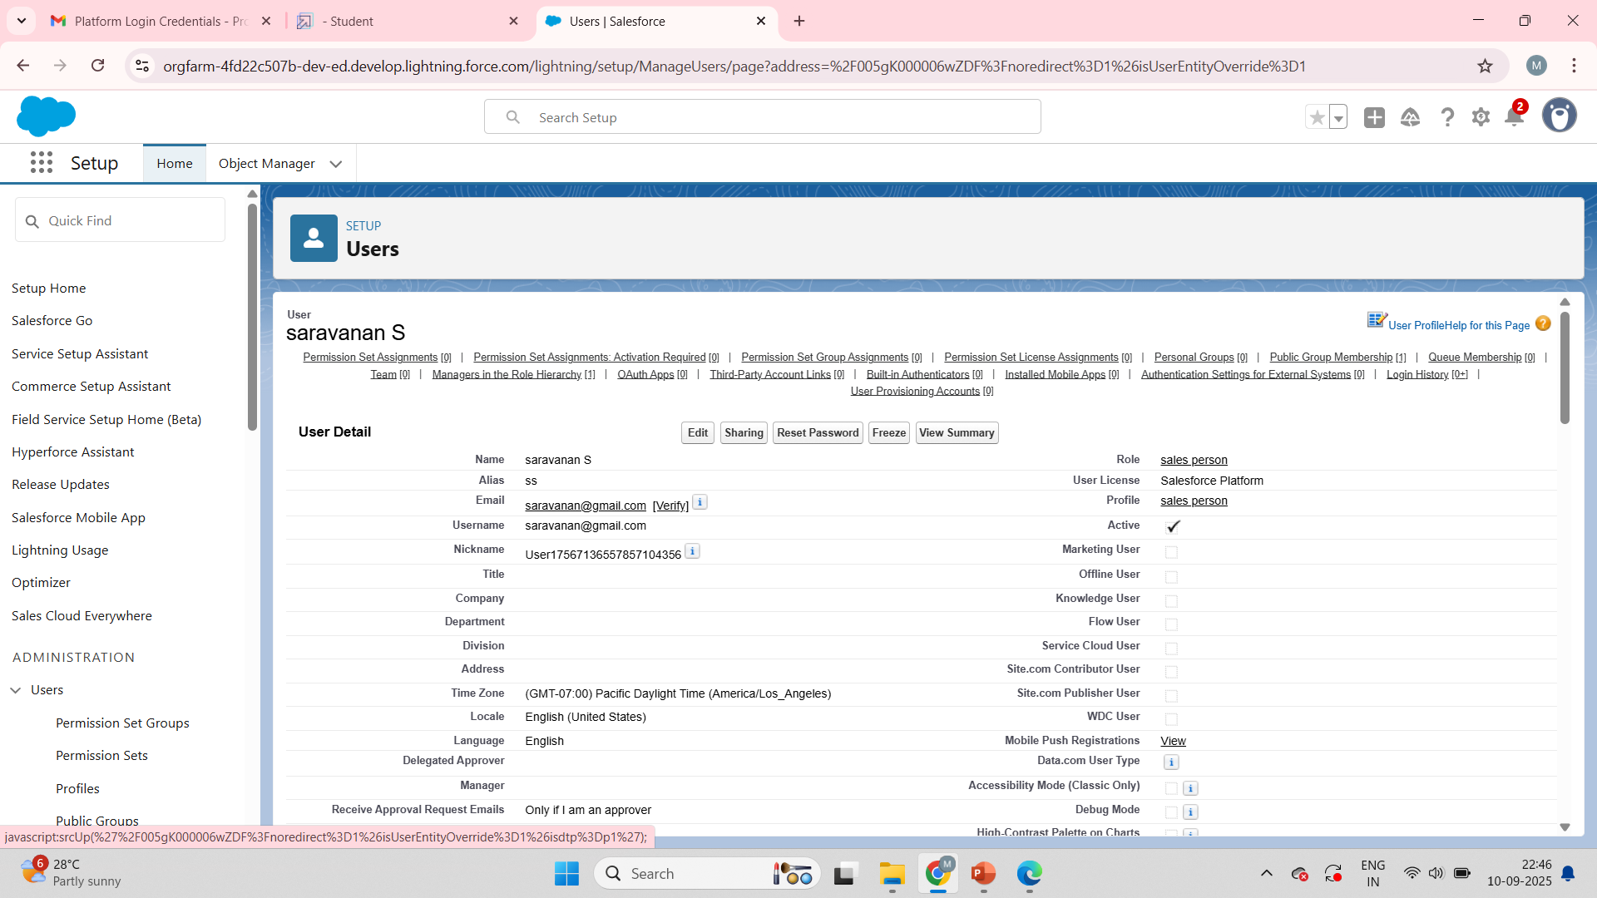


Slide 17
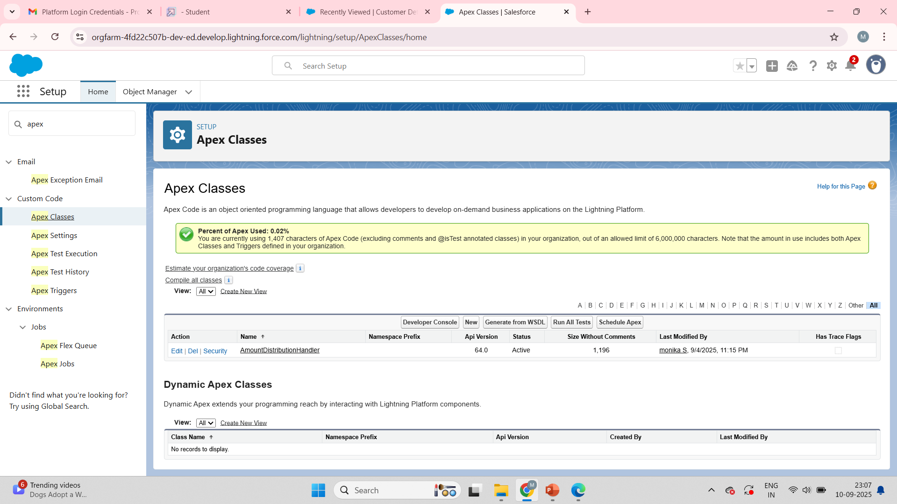
Apex Handler

Slide 18
AmountDistributionHandler
public class AmountDistributionHandler {
public static void amountDist(list<Appointment__c> listApp){
list<Service_records__c> serList = new list <Service_records__c>();
for(Appointment__c app : listApp){
if(app.Maintenance_service__c == true && app.Repairs__c == true && app.Replacement_Parts__c == true){
app.Service_Amount__c = 10000;
}
else if(app.Maintenance_service__c == true && app.Repairs__c == true){
app.Service_Amount__c = 5000;
}
else if(app.Maintenance_service__c == true && app.Replacement_Parts__c == true){
app.Service_Amount__c = 8000;
}

Slide 19
else if(app.Repairs__c == true && app.Replacement_Parts__c == true){
app.Service_Amount__c = 7000;
}
else if(app.Maintenance_service__c == true){
app.Service_Amount__c = 2000;
}
else if(app.Repairs__c == true){
app.Service_Amount__c = 3000;
}
else if(app.Replacement_Parts__c == true){
app.Service_Amount__c = 5000;
}
}
}
}

Slide 20
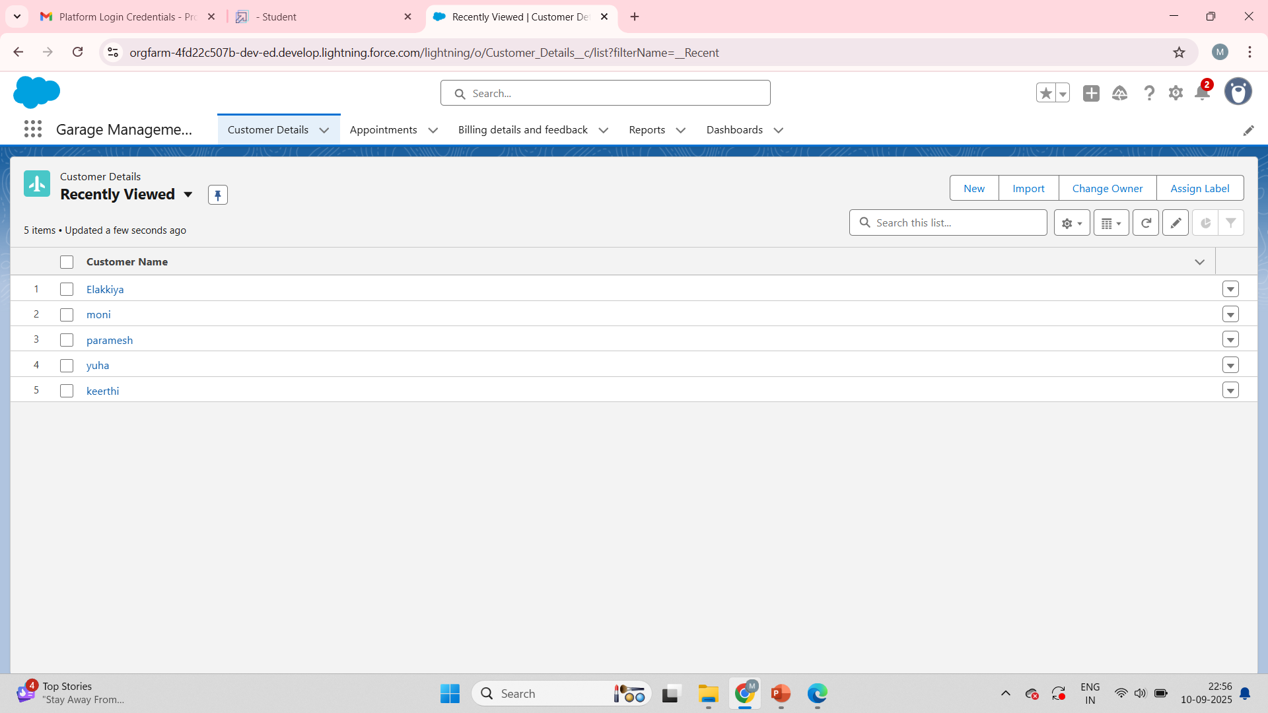
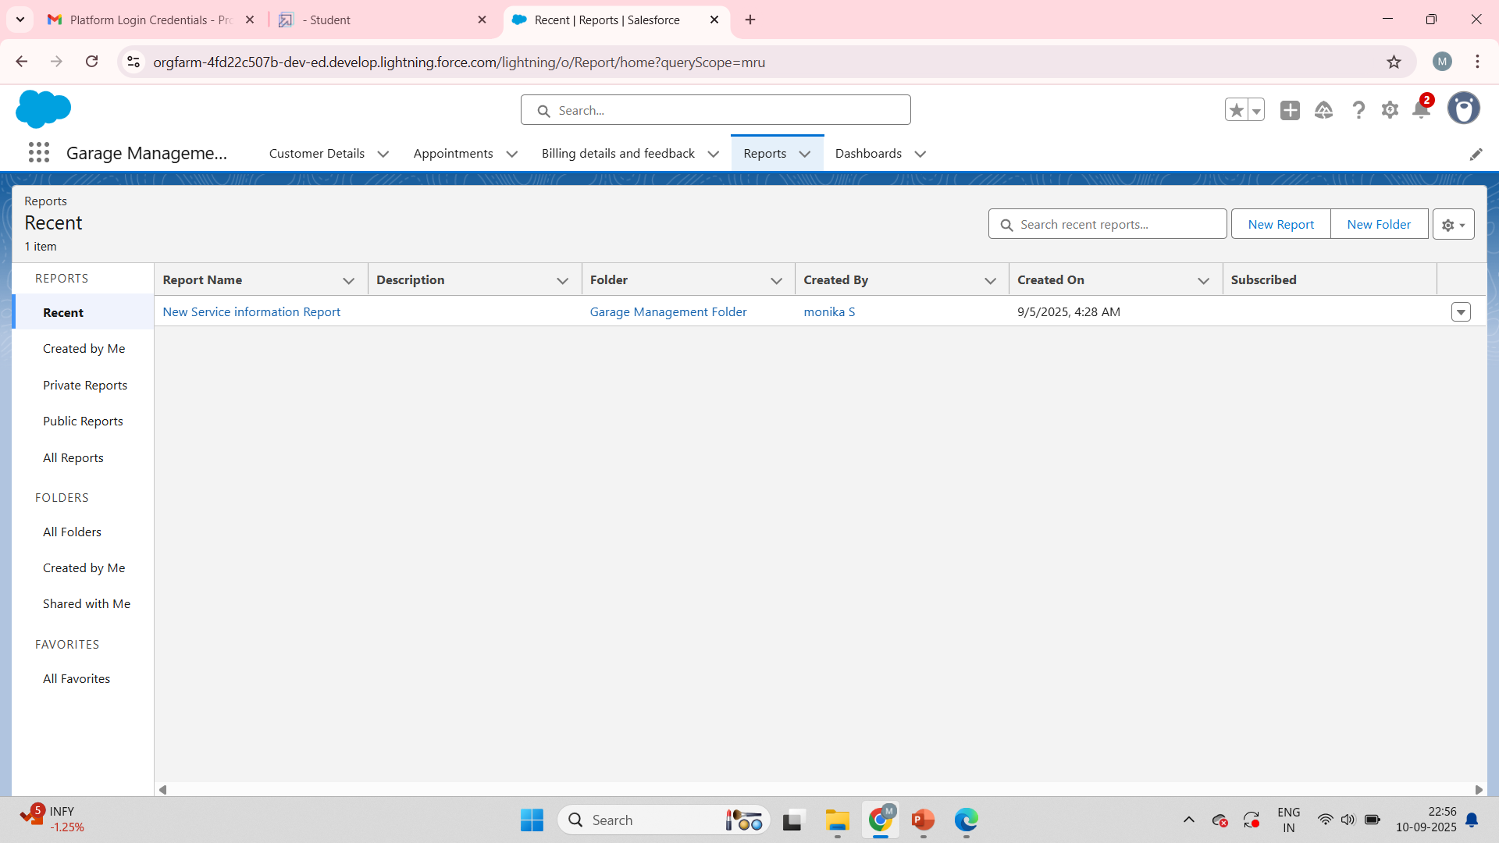
Output

Slide 21
